Slide 1
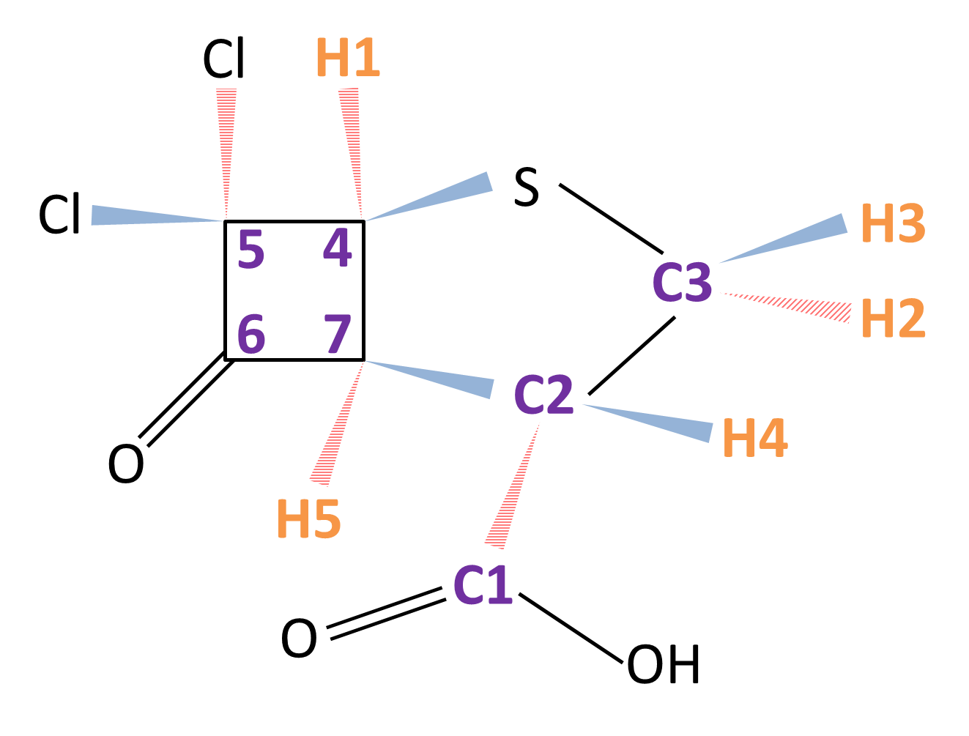

 | C1 | C2 | C3 | C4 | C5 | C6 | C7 | H1 | H2 | H3 | H4 | H5
C1 | 30031
C2 | 57.56 | 8787
C3 | -2.03 | 32.70 | 6248
C4 | -0.96 | 0.50 | 0 | 10334
C5 | -1.14 | 2.80 | 1.11 | 33.07 | 15746
C6 | 5.54 | -1.70 | 0 | -3.53 | -33.50 | 34382
C7 | 0.97 | 37.48 | 0.94 | -29.02 | -21.75 | 34.57 | 11932
H1 |  |  |  |  |  |  |  | 3310
H2 |  |  |  |  |  |  |  | 0 | 2468
H3 |  |  |  |  |  |  |  | 0.18 | -12.41 | 2158
H4 |  |  |  |  |  |  |  | -0.68 | 1.28 | 6.00 | 2692
H5 |  |  |  |  |  |  |  | 8.46 | -1.06 | -0.36 | 1.30 | 3649
C-13 labeled 12-qubit system
$${\text{C}}_{\text{7}}{\text{H}}_{\text{6}}{\text{Cl}}_{\text{2}}{\text{SO}}_{\text{3}}$$

